Slide 1
Graph Essentials
Social Media Mining

Slide 2
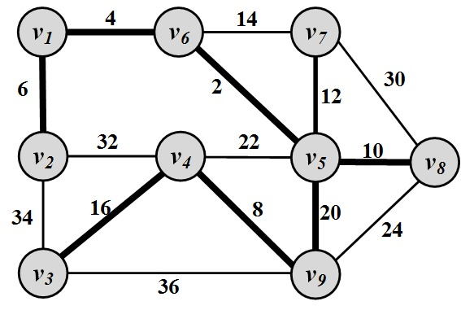
Networks
A network is a graph.
Elements of the network have meanings
Network problems can usually be represented in terms of graph theory
Twitter example:
Given a piece of information, a network of individuals, and the cost to propagate information among any connected pair, find the minimum cost to disseminate the information to all individuals.

Slide 3
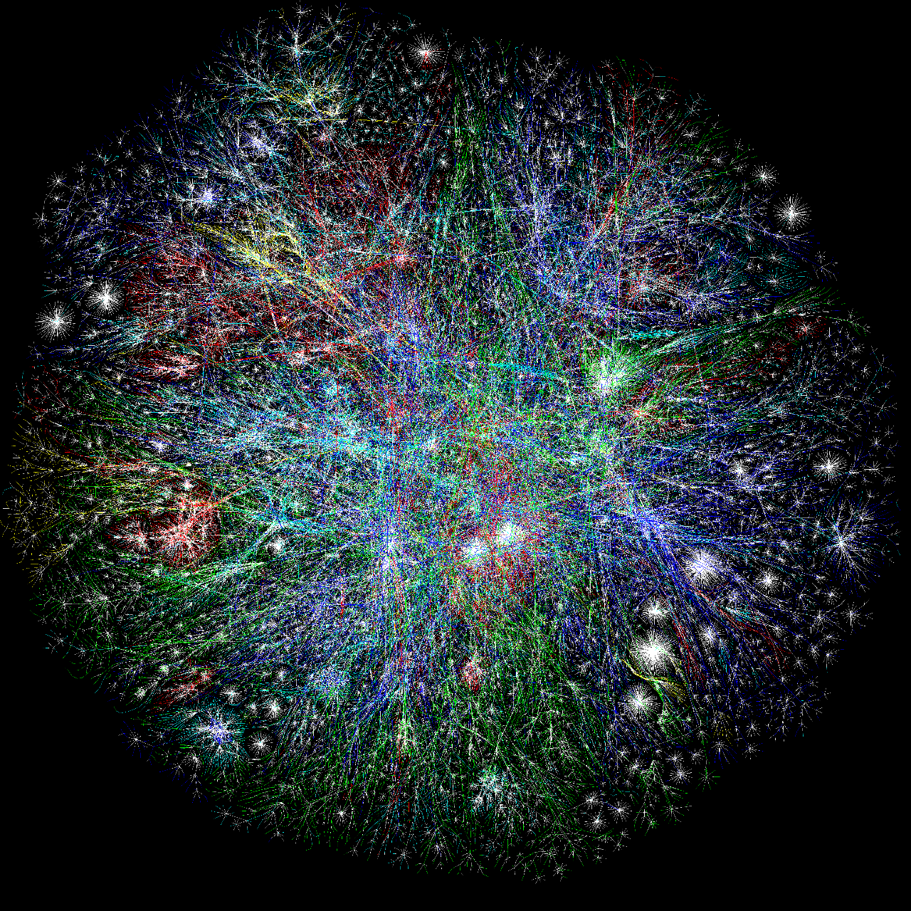
Internet

Slide 4
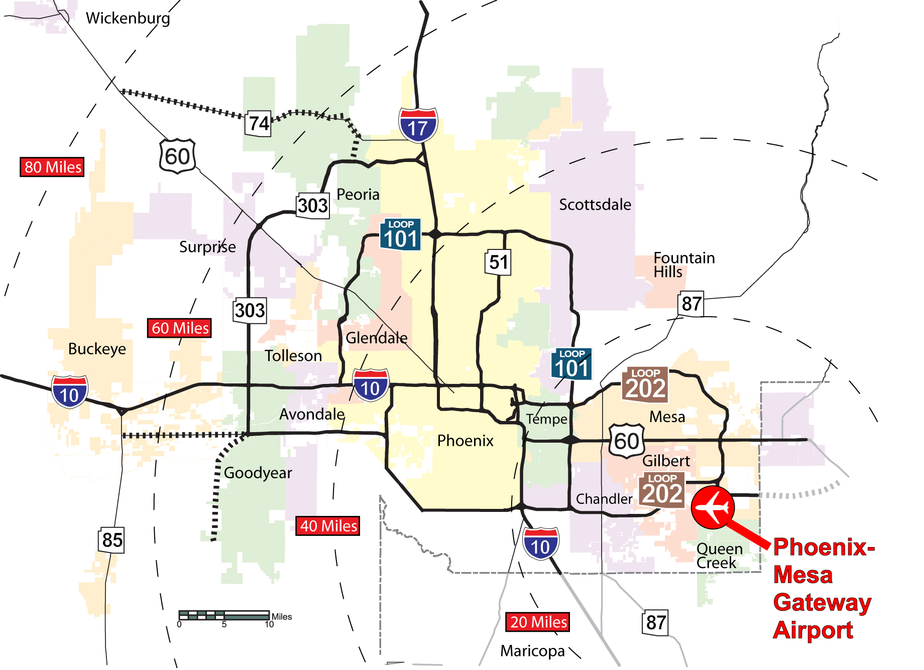
Phoenix Road Network
Notes:
http://www.autoblog.com/2011/12/21/new-art-reimagines-u-s-road-network-system-as-a-subway-map/

Slide 5
Social Networks and Social Network Analysis
A social network
A network where elements have a social structure
A set of actors (such as individuals or organizations)
A set of ties (connections between individuals)
Social networks examples:
your family network, your friend network, your colleagues ,etc.
To analyze these networks we can use Social Network Analysis (SNA)
Social Network Analysis is an interdisciplinary field from social sciences, statistics, graph theory, complex networks, and now computer science
Notes:
http://en.wikipedia.org/wiki/Social_network
Network science studies the laws and patterns of different networks in one context.

Slide 6
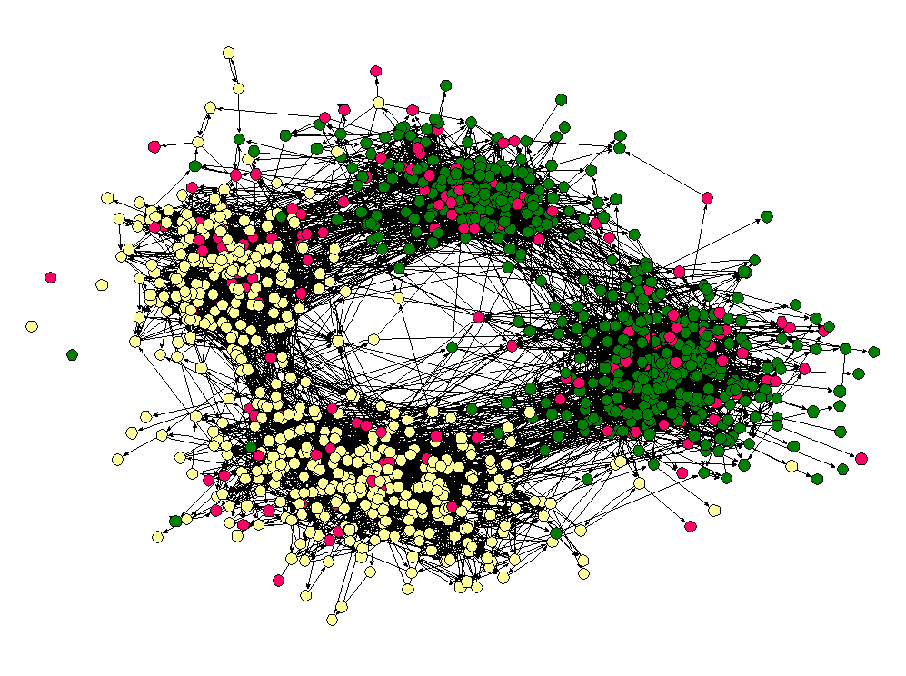
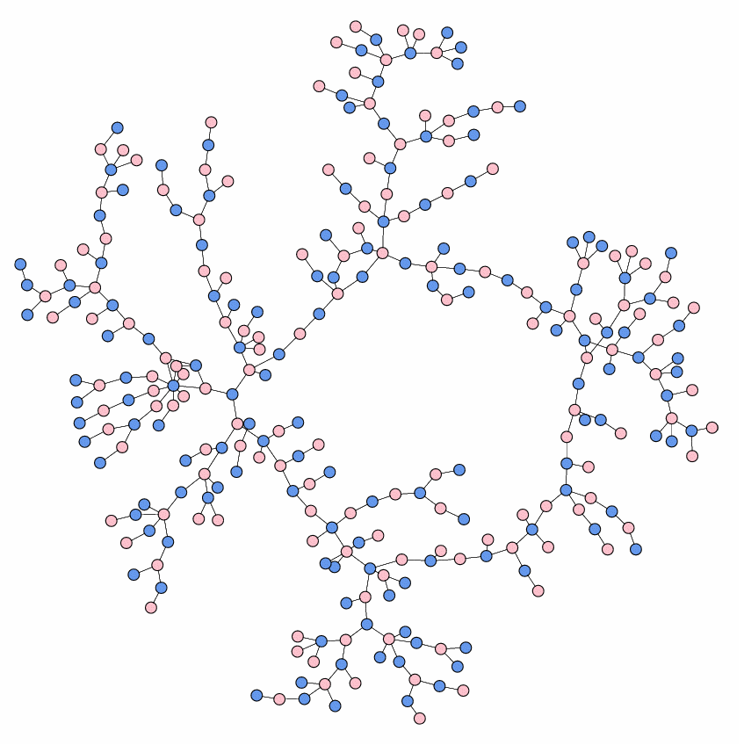
Social Networks: Examples
High school friendship
High school dating
Notes:
http://www-personal.umich.edu/~mejn/networks/
James Moody, Race, school integration, and friendship segregation in America, American Journal of Sociology 107, 679-716 (2001): Yellow = girls, Green = boys, Red = sexually active
High school dating: Data drawn from Peter S. Bearman, James Moody, and Katherine Stovel, Chains of affection: The structure of adolescent romantic and sexual networks, American Journal of Sociology 110, 44-91 (2004) image was made by M Newman

Slide 7
Graph Basics

Slide 8
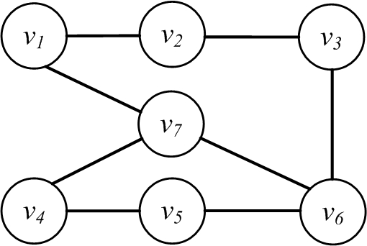
Nodes and Edges
A network is a graph, or a collection of points connected by lines
Points are referred to as nodes, actors, or vertices (plural of vertex)
Connections are referred to as edges or ties
Edge
Node

Slide 9
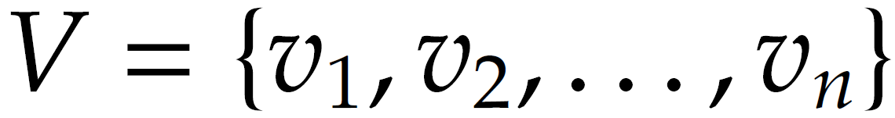
Nodes or Actors
In a friendship social graph, nodes are people and any pair of people connected denotes the friendship between them
Depending on the context, these nodes are called nodes, or actors
In a web graph, “nodes” represent sites and the connection between nodes indicates web-links between them
In a social setting, these nodes are called actors
The size of the graph is |V|= n

Slide 10
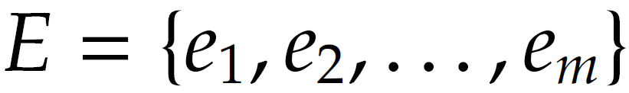
Edges
Edges connect nodes and are also known as ties or relationships
In a social setting, where nodes represent social entities such as people, edges indicate internode relationships and are therefore known as relationships or (social) ties
Number is edges (size of the edge-set) is denoted as |E|=m

Slide 11
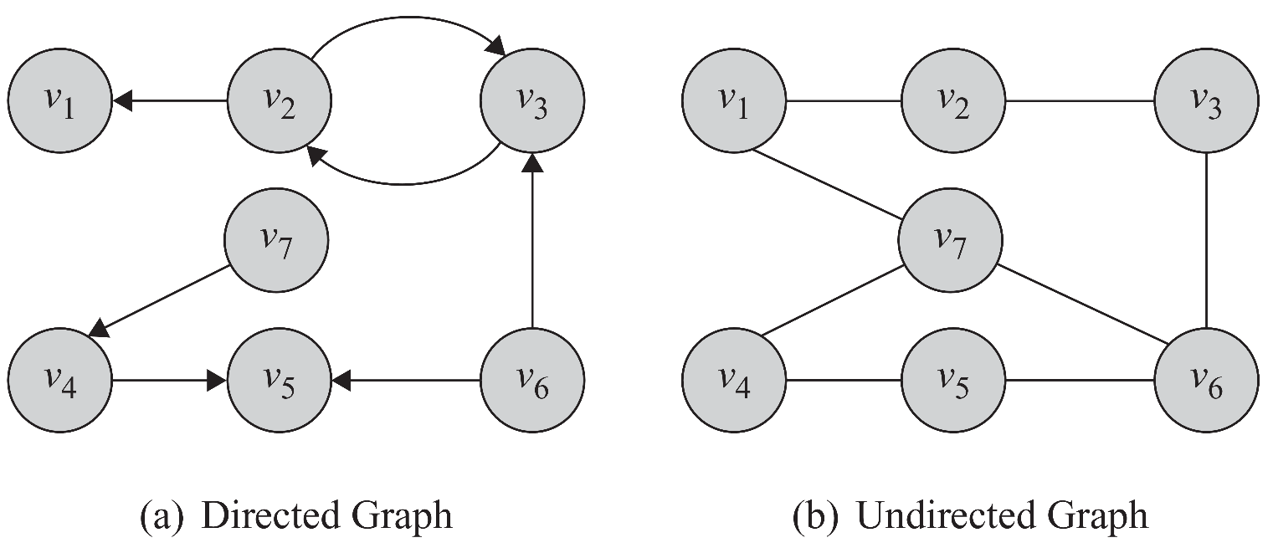
Directed Edges and Directed Graphs
Edges can have directions. A directed edge is sometimes called an arc
Edges are represented using their end-points e(v2,v1). In undirected graphs both representations are the same

Slide 12
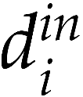
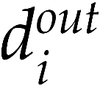
Neighborhood and Degree (In-degree, out-degree)
For any node v, the set of nodes it is connected to via an edge is called its neighborhood and is represented as N(v)
The number of edges connected to one node is the degree of that node (the size of its neighborhood)
Degree of a node i is usually presented using notation di
In case of directed graphs
In-degrees is the number of edges pointing towards a node
Out-degree is the number of edges pointing away from a node

Slide 13
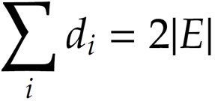
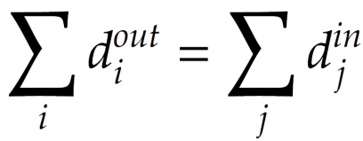
Degree and Degree Distribution
Theorem 1. The summation of degrees in an undirected graph is twice the number of edges
Lemma 1. The number of nodes with odd degree is even
Lemma 2. In any directed graph, the summation of in-degrees is equal to the summation of out-degrees,

Slide 14
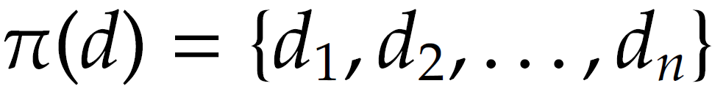
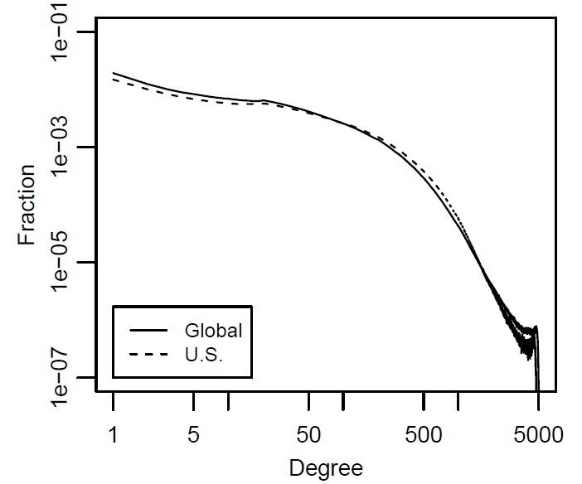
Degree Distribution
When dealing with very large graphs, how nodes’ degrees are distributed is an important concept to analyze and is called Degree Distribution
Where is the number of nodes with degree d
Degree distribution can be computed from degree sequence:
Degree distribution histogram
The x-axis represents the degree and the y-axis represents the number of nodes (frequency) having that degree

Slide 15
Subgraph
Graph G can be represented as a pair G(V; E), where V is the node set and E is the edge set
G’(V’,E’) is a subgraph of G(V,E)
6
4
5
5
1
3
1
3
2
2

Slide 16
Graph Representation
Adjacency Matrix
Adjacency List
Edge List

Slide 17
Graph Representation
Graph representation is straightforward and intuitive, but it cannot be effectively manipulated using mathematical and computational tools
We are seeking representations that can store these two sets in a way such that
Does not lose information
Can be manipulated easily by computers
Can have mathematical methods applied easily

Slide 18
Adjacency Matrix
1, if there is an edge between nodes vi and vj
0, otherwise
Diagonal Entries are self-links or loops
Social media networks have
very sparse Adjacency matrices

Slide 19
Adjacency List
In an adjacency list for every node, we maintain a list of all the nodes that it is connected to
The list is usually sorted based on the node order or other preferences

Slide 20
Edge List
In this representation, each element is an edge and is usually represented as (u, v), denoting that node u is connected to node v via an edge

Slide 21
Types of Graphs
Null, Empty, Directed/Undirected/Mixed, Simple/Multigraph, Weighted, Webgraph, Signed Graph

Slide 22
Null Graph and Empty Graph
A null graph is one where the node set is empty (there are no nodes)
Since there are no nodes, there are also no edges
G(V, E), V = E = ∅
An empty graph or edge-less graph is one where the edge set is empty, E = ∅
The node set can be non-empty.
A null-graph is an empty graph.

Slide 23
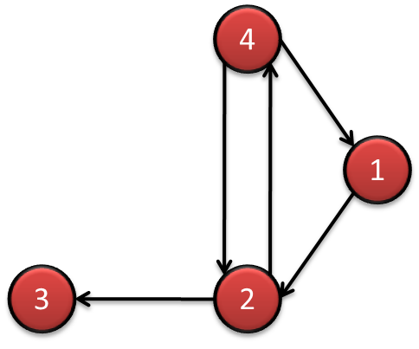
Directed/Undirected/Mixed Graphs
4
1
3
2
The adjacency matrix for directed graphs is not symmetric (A ≠ A^{T})
(A_{ij} ≠ A_{ji})
The adjacency matrix for undirected graphs is symmetric (A = A^{T})

Slide 24
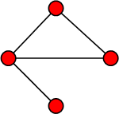
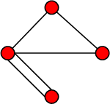
Simple Graphs and Multigraphs
Simple graphs are graphs where only a single edge can be between any pair of nodes
Multigraphs are graphs where you can have multiple edges between two nodes and loops
The adjacency matrix for multigraphs can include numbers larger than one, indicating multiple edges between nodes
Simple graph
Multigraph
Notes:
It is important for social network analysis as a pair can have more than one relations.

Slide 25
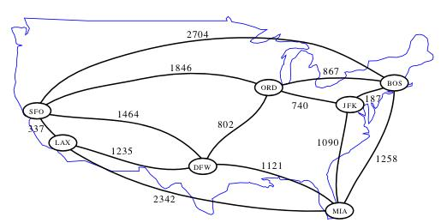
Weighted Graph
A weighted graph is one where edges are associated with weights
For example, a graph could represent a map where nodes are cities and edges are routes between them
The weight associated with each edge could represent the distance between these cities
G(V, E, W)
Notes:
Image: http://www.cs.ucr.edu/~neal/2004/cs141/?ShortestPathsByDijkstras

Slide 26
Webgraph
A webgraph is a way of representing how internet sites are connected on the web
In general, a web graph is a directed multigraph
Nodes represent sites and edges represent links between sites.
Two sites can have multiple links pointing to each other and can have loops (links pointing to themselves)

Slide 27
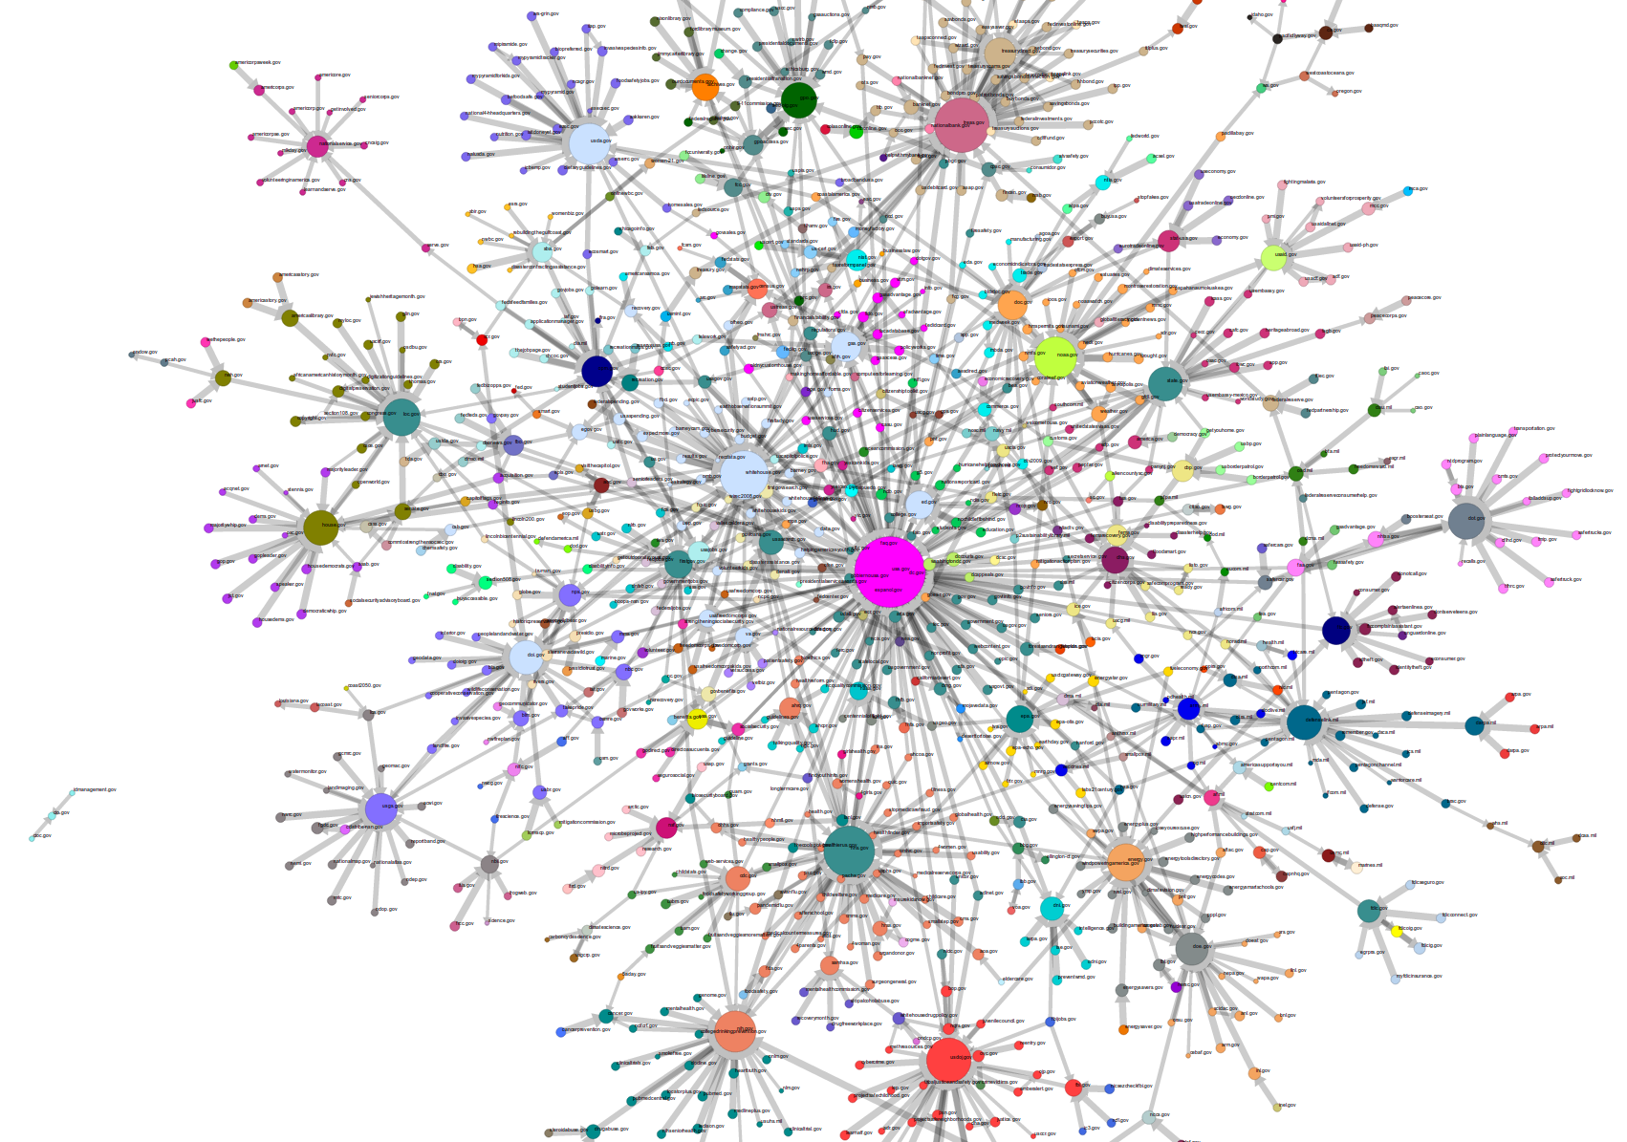
Webgraph: Government Agencies
Notes:
Image: http://research.library.unt.edu/eotcd/wiki/File:gov_20.png

Slide 28
Signed Graph
When weights are binary (0/1, -1/1, +/-) we have a signed graph
It is used to represent friends or foes
It is also used to represent social status

Slide 29
Connectivity in Graphs
Adjacent nodes/Edges, Walk/Path/Trail/Tour/Cycle,

Slide 30
Adjacent nodes and Incident Edges
Two nodes are adjacent if they are connected via an edge.
Two edges are incident, if they share on end-point
When the graph is directed, edge directions must match for edges to be incident
An edge in a graph can be traversed when one starts
at one of its end-nodes, moves along the edge, and stops at its other end-node.

Slide 31
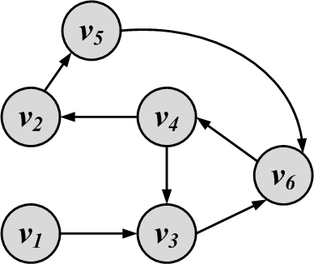
Walk, Path, Trail, Tour, and Cycle
Walk: A walk is a sequence of incident edges visited one after another
Open walk: A walk does not end where it starts
Close walk: A walk returns to where it starts
Representing a walk:
A sequence of edges: e₁, e₂, …, e_{n}
A sequence of nodes: v₁, v₂, …, v_{n}
Length of walk: the number of visited edges
Length of walk= 8

Slide 32
Trail
A trail is a walk where no edge is visited more than once and all walk edges are distinct
A closed trail (one that ends where it starts) is called a tour or circuit

Slide 33
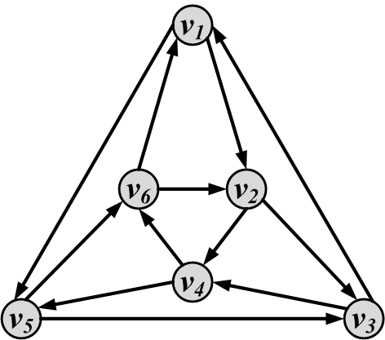
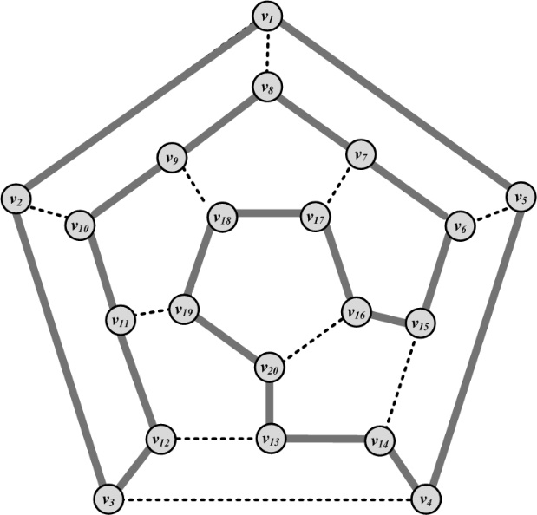
Examples
Eulerian Tour
All edges are traversed only once
Konigsberg bridges
Hamiltonian Cycle
A cycle that visits all nodes

Slide 34
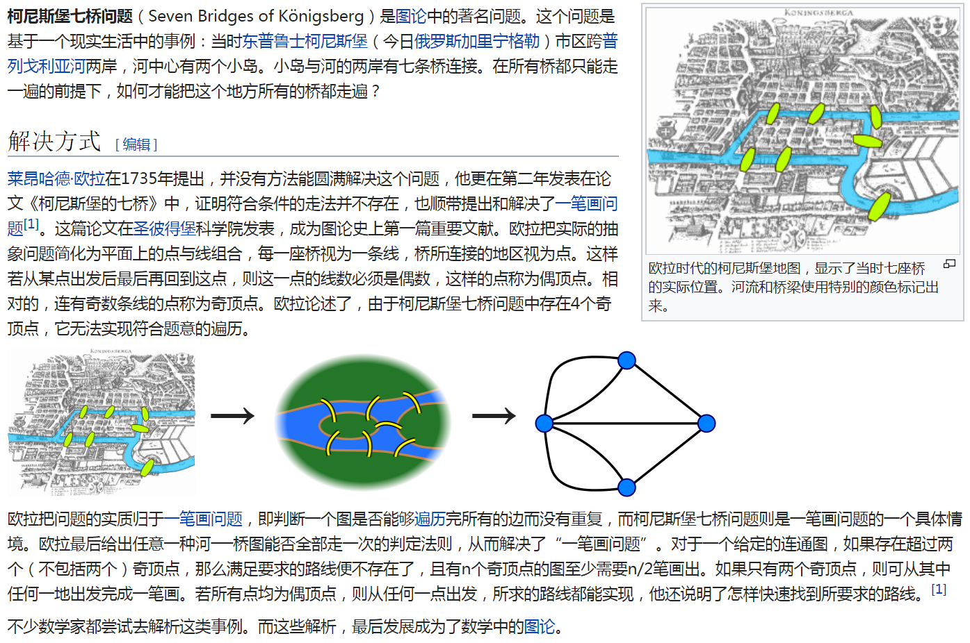

Slide 35
Path
A walk where nodes and edges are distinct is called a path and a closed path is called a cycle
The length of a path or cycle is the number of edges visited in the path or cycle
Length of path= 4

Slide 36
Random walk
A walk that in each step the next node is selected randomly among the neighbors
The weight of an edge can be used to define the probability of visiting it
For all edges that start at v_{i} the following equation holds

Slide 37
Connectivity
A node v_{i} is connected to node v_{j} (or reachable from v_{j}) if it is adjacent to it or there exists a path from v_{i} to v_{j.}
A graph is connected, if there exists a path between any pair of nodes in it
In a directed graph, a graph is strongly connected if there exists a directed path between any pair of nodes
In a directed graph, a graph is weakly connected if there exists a path between any pair of nodes, without following the edge directions
A graph is disconnected, if it not connected.

Slide 38
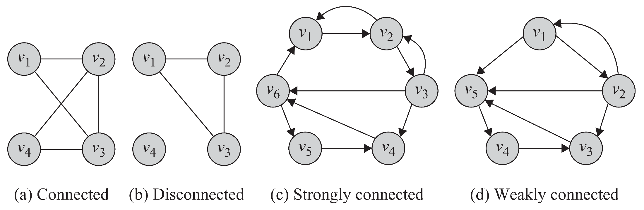
Connectivity: Example

Slide 39
Component
A component in an undirected graph is a connected subgraph, i.e., there is a path between every pair of nodes inside the component
In directed graphs, we have a strongly connected components when there is a path from u to v and one from v to u for every pair (u,v).
The component is weakly connected if replacing directed edges with undirected edges results in a connected component

Slide 40
Component Examples:
3 components
3 Strongly-connected
components

Slide 41
Shortest Path
Shortest Path is the path between two nodes that has the shortest length.
We denote the length of the shortest path between nodes v_{i} and v_{j} as
The concept of the neighborhood of a node can be generalized using shortest paths. An n-hop neighborhood of a node is the set of nodes that are within n hops distance from the node.

Slide 42
Diameter
The diameter of a graph is the length of the longest shortest path between any pair of nodes between any pairs of nodes in the graph
How big is the diameter of the web?

Slide 43
Special Graphs

Slide 44
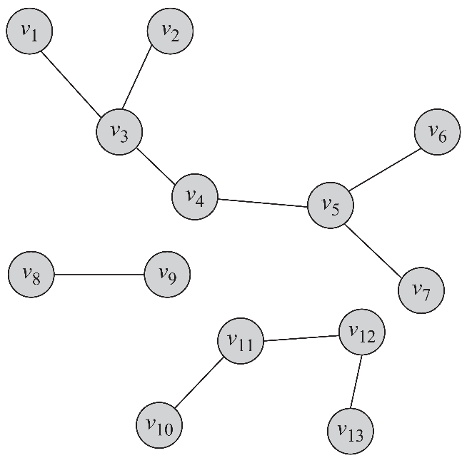
Trees and Forests
Trees are special cases of undirected graphs
A tree is a graph structure that has no cycle in it
In a tree, there is exactly one path between any pair of nodes
In a tree: |V| = |E| + 1
A set of disconnected trees is called a forest
A forest containing 3 trees

Slide 45
Special Subgraphs

Slide 46
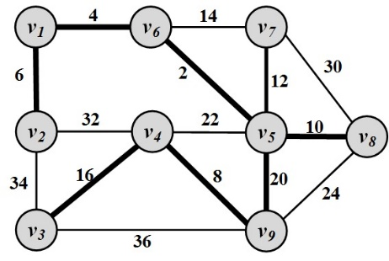
Spanning Trees
For any connected graph, the spanning tree is a subgraph and a tree that includes all the nodes of the graph
There may exist multiple spanning trees for a graph.
For a weighted graph and one of its spanning tree, the weight of that spanning tree is the summation of the edge weights in the tree.
Among the many spanning trees found for a weighted graph, the one with the minimum weight
is called the
minimum spanning tree (MST)

Slide 47
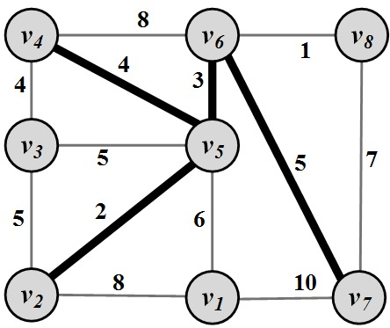
Steiner Trees
Given a weighted graph G : (V, E, W) and a subset of nodes V’ ⊆ V (terminal nodes ), the Steiner tree problem aims to find a tree such that it spans all the V’ nodes and the weight of this tree is minimized

Slide 48
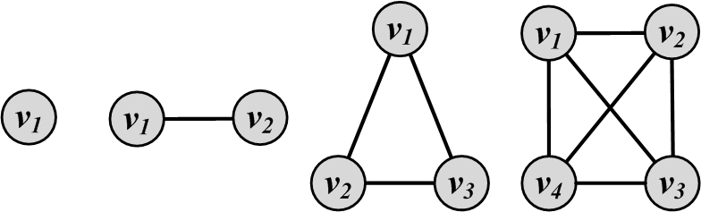
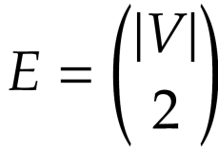
Complete Graphs
A complete graph is a graph where for a set of nodes V, all possible edges exist in the graph
In a complete graph, any pair of nodes are connected via an edge

Slide 49
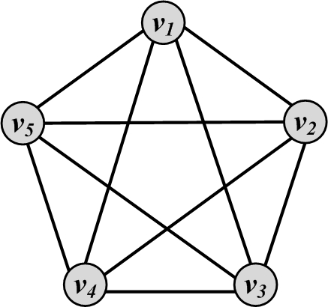
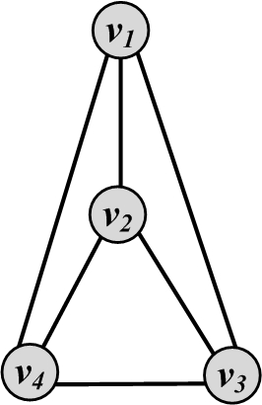
Planar Graphs
A graph that can be drawn in such a way that no two edges cross each other (other than the endpoints) is called planar
Planar Graph
Non-planar Graph

Slide 50
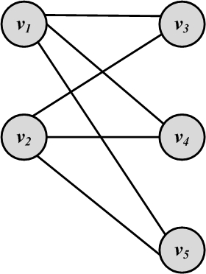
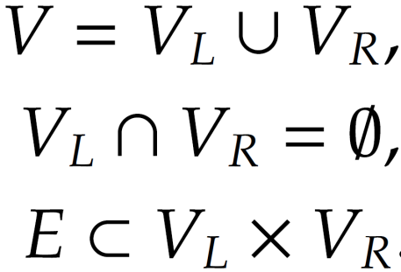
Bipartite Graphs
A bipartite graph G(V; E) is a graph where the node set can be partitioned into two sets such that, for all edges, one end-point is in one set and the other end-point is in the other set.

Slide 51
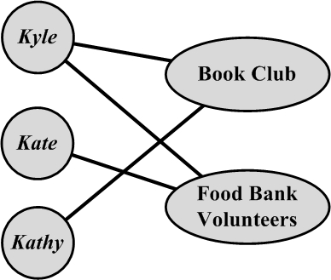
Affiliation Networks
An affiliation network is a bipartite graph. If an individual is associated with an affiliation, an edge connects the corresponding nodes.

Slide 52
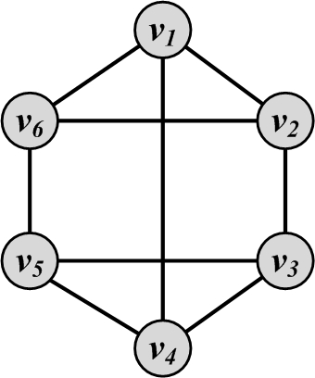
Regular Graphs
A regular graph is one in which all nodes have the same degree
Regular graphs can be connected or disconnected
In a k-regular graph, all nodes have degree k
Complete graphs are examples of regular graphs

Slide 53
Egocentric Networks
An egocentric network consists of a focal actor (ego), and a set of alters who have ties with the ego
In an egocentric network, usually there are limitations for nodes to connect to other nodes or have relation with other nodes
For example, in a network of mothers and their children, each mother only holds mother-children relations with her own children
Additional examples of egocentric networks are Teacher-Student or Husband-Wife

Slide 54
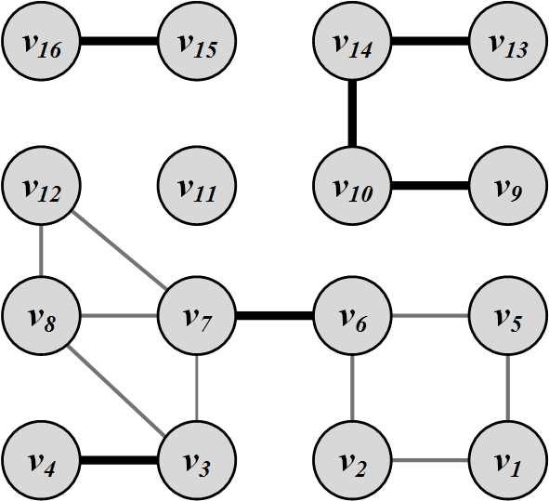
Bridges (cut-edges)
Bridges are edges whose removal will increase the number of connected components

Slide 55
Graph Algorithms

Slide 56
Graph/Network Traversal Algorithms

Slide 57
Graph/Tree Traversal
Consider a social media site that has many users and we are interested in surveying the site and computing the average age of its users. The usual technique is to start from one user and employ some traversal technique to browse his friends and then these friends’ friends and so on. The traversal technique guarantees that
1. All users are visited; and
2. No user is visited more than once.
There are two main techniques:
Depth-First Search (DFS)
Breadth-First Search (BFS)

Slide 58
Depth-First Search (DFS)
Depth-First Search (DFS) starts from a node i, selects one of its neighbors j from N(i) and performs Depth-First Search on j before visiting other neighbors in N(i).
The algorithm can be used both for trees and graphs
The algorithm can be implemented using a stack structure

Slide 59
DFS Algorithm

Slide 60
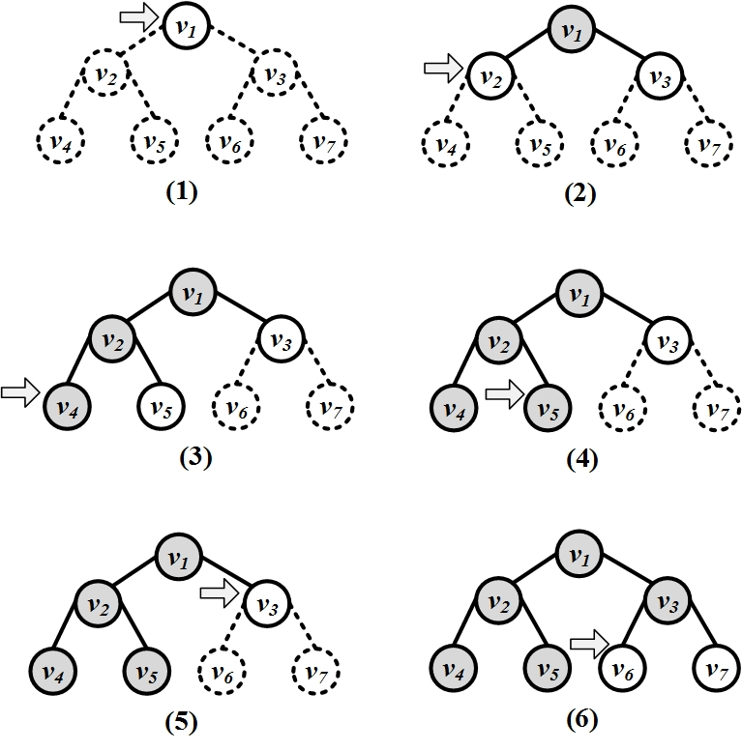
Depth-First Search (DFS): An Example

Slide 61
Breadth-First Search (BFS)
BFS starts from a node, visits all its immediate neighbors first, and then moves to the second level by traversing their neighbors.
The algorithm can be used both for trees and graphs
The algorithm can be implemented using a queue structure

Slide 62
BFS Algorithm

Slide 63
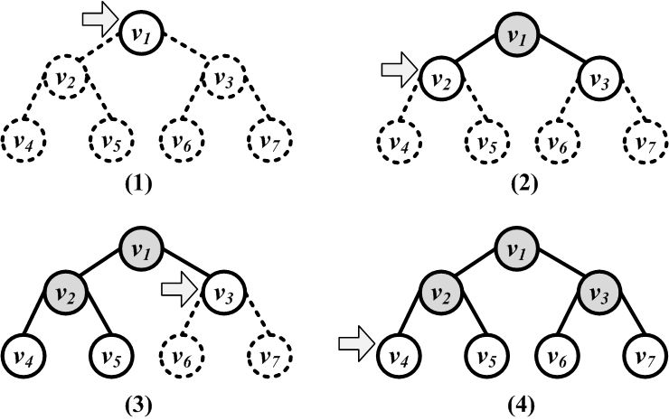
Breadth-First Search (BFS)

Slide 64
Shortest Path
When a graph is connected, there is a chance that multiple paths exist between any pair of nodes
In many scenarios, we want the shortest path between two nodes in a graph
Dijkstra’s Algorithm
It is designed for weighted graphs with non-negative edges
It finds shortest paths that start from a provided node s to all other nodes
It finds both shortest paths and their respective lengths

Slide 65
Dijkstra’s Algorithm: Finding the shortest path
Initiation:
Assign zero to the source node and infinity to all other nodes
Mark all nodes unvisited
Set the source node as current
For the current node, consider all of its unvisited neighbors and calculate their tentative distances
If tentative distance (current node’s distance + edge weight) is smaller than neighbor’s distance, then Neighbor’s distance = tentative distance
After considering all of the neighbors of the current node, mark the current node as visited and remove it from the unvisited set
A visited node will never be checked again and its distance recorded now is final and minimal
If the destination node has been marked visited or if the smallest tentative distance among the nodes in the unvisited set is infinity, then stop
Set the unvisited node marked with the smallest tentative distance as the next "current node" and go to step 2

Slide 66
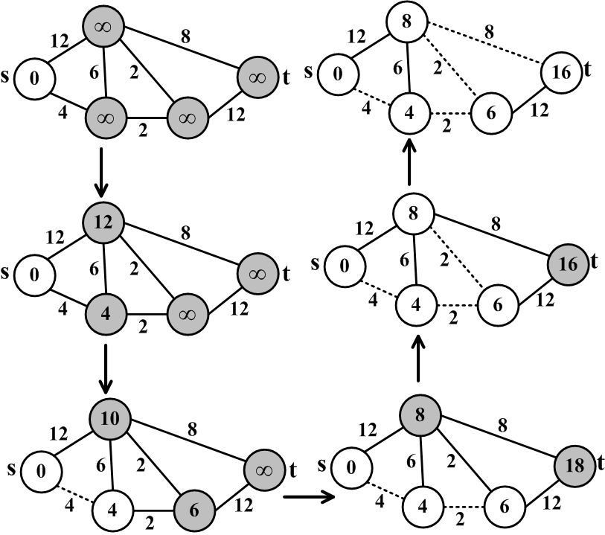
Dijkstra’s Algorithm Execution Example

Slide 67
Dijkstra’s Algorithm
Dijkstra’s algorithm is source-dependent and finds the shortest paths between the source node and all other nodes. To generate all-pair shortest paths, one can run dijsktra’s algorithm n times or use other algorithms such as Floyd-Warshall algorithm.
If we want to compute the shortest path from source v to destination d, we can stop the algorithm once the shortest path to the destination node has been determined

Slide 68
Prim’s Algorithm: Finding Minimum Spanning Tree
It finds minimal spanning trees in a weighted graph
It starts by selecting a random node and adding it to the spanning tree.
It then grows the spanning tree by selecting edges which have one endpoint in the existing spanning tree and one endpoint among the nodes that are not selected yet. Among the possible edges, the one with the minimum weight is added to the set (along with its end-point).
This process is iterated until the graph is fully spanned

Slide 69
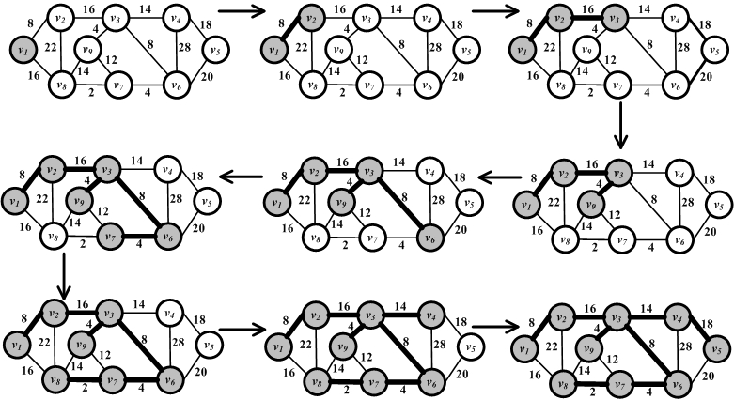
Prim’s Algorithm Execution Example

Slide 70
Bridge Detection

